Slide 1
JavaScript 101

Slide 2
Programming Logic
Prep for Javascript/jQuery I:
Complete Bootstrap Project and any other unfinished projects.
Upload them to the web server and send the instructor a link.
All projects should be linked from your portfolio page
Watch: https://teamtreehouse.com/library/javascript-basics [381 min]

Slide 3
Intro to Programming | Overview
Today's Topics:
Bootstrap 2 Review
Debugging suggestions [separate document]
Programming Terms
Programming Logic

Slide 4
Programming Terms
1
Let's start with the way we speak.

Slide 5
Terminology
Developers have their own language and understanding what certain words mean, will help you communicate with not only other developers but with the computer as well.
Basic Programming
Syntax
Parse
Expression
Scope
Function
Parameters
Variable
Data Types
Concatenate
Instantiate
Invoke / Call / Execute
Debug
JavaScript Specific
DOM
Console
Browser / Client
https://www.tutorialsteacher.com/javascript/javascript-tutorials

Slide 6
Basic Programming Terminology

Slide 7
Terminology | Basic
Syntax : is a set of rules that defines the combinations of symbols that are considered to be correctly structured document or fragment in a language. Basically consists of commands, a special word, and punctuation.
JavaScript Syntax :
var posX = 20;
var posY = 30;
function init(){
// do something
displayName()
}
function displayName(){
// do something
}
init()
PHP Syntax :
<?php
$posX = 20;
$posY = 30;
function init(){
// do something
displayName()
}
function displayName(){
// do something
}
init()
CSS Syntax :
.myDiv{
border: 1px solid red;
font-size: 20px;
}
h1#page-title{
font-size: 40px;
color: #222;
text-align: center;
}

Slide 8
Terminology | Basic
Parse : to analyze (a string of characters/sentence) in order to associate groups of characters with the syntactic units of the underlying grammar.
The word "parse" means to analyze an object specifically. It is commonly used in computer science to refer to reading program code.
function init(){
// do something
displayName();
}
function displayName(){
// do something
}
init();

Slide 9
Programming Logic
Operators
= assigns value
== equal to
!= is not equal to
< is less than
> is greater than
<= is less than or equal to
>= is greater than or equal to
+, -, *, / math operators
+ string concatenation (when used with strings)
|| “or”
&& “and”

Slide 10
Programming Logic
Operator Types
JavaScript includes following categories of operators.
Arithmetic Operators
Comparison Operators
Logical Operators
Assignment Operators
Conditional Operators

Slide 11
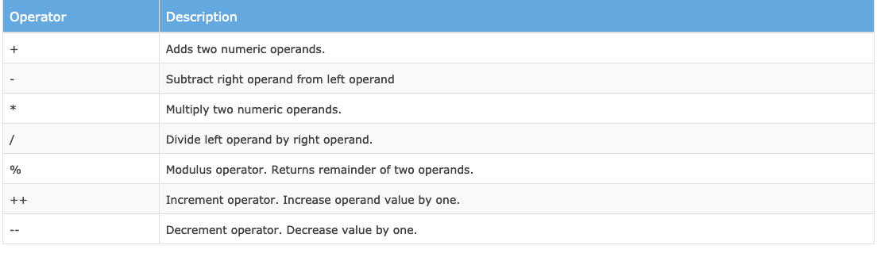
Programming Logic
Arithmetic Operator used to perform mathematical operations between numeric operands.
https://www.w3schools.com/jsref/tryit.asp?filename=tryjsref_oper_add

Slide 12
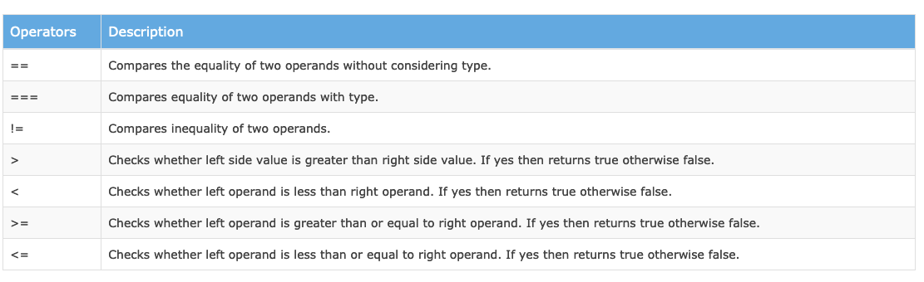
Programming Logic
Comparison Operator- includes operators that compare two operands and return Boolean value true or false.
https://www.w3schools.com/jsref/tryit.asp?filename=tryjsref_comparison1

Slide 13
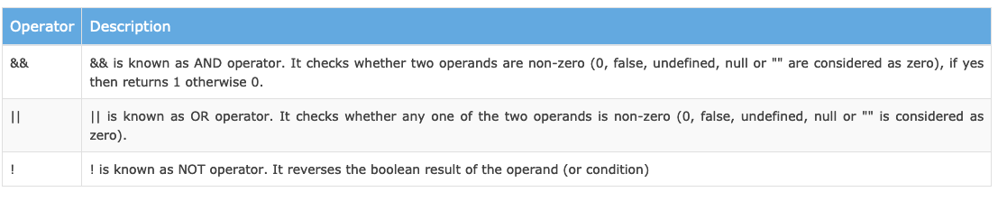
Programming Logic
Logical Operator - used to combine two or more conditions
https://www.w3schools.com/jsref/tryit.asp?filename=tryjsref_oper_and

Slide 14
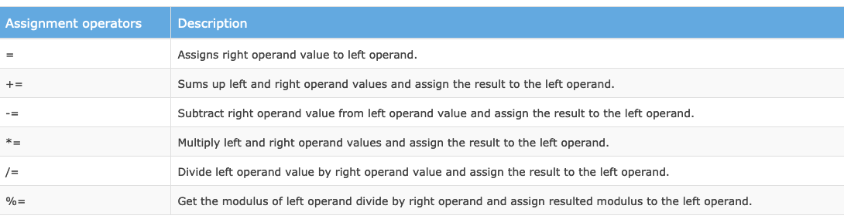
Programming Logic
Assignment Operator - used to assign values to variables with less keystrokes https://www.w3schools.com/jsref/jsref_operators.asp

Slide 15
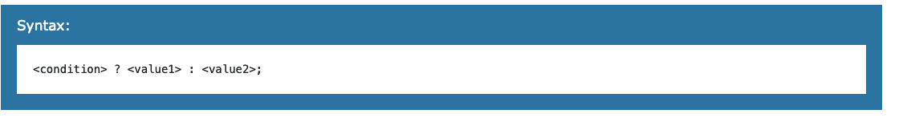
Programming Logic
Ternary Operator - special operator that assigns a value to a variable based on some condition. This is like short form of if-else condition. (may not use in this course)
Voteable = (age < 18) ? "Too young":"Old enough";
https://www.w3schools.com/jsref/tryit.asp?filename=tryjsref_comparison

Slide 16
Programming Logic
Common Operators Summary:
= assigns value
== equal to
!= is not equal to
< is less than
> is greater than
<= is less than or equal to
>= is greater than or equal to
+, -, *, / math operators
+ string concatenation (when used with strings)
|| “or”
&& “and”

Slide 17
Terminology | Basic
Expression: a sequence of variables, constants and operators which evaluate to a single value.
(Basically any unit of code that can be evaluated to a value is an expression)
5
5 - 3
x
x + 67
x < 5
x - 3 > 5 + y
z == y + 23
high_score() >= 50
x > 5 && x < 10
Notes:
Discuss what these evaluate to

Slide 18
Terminology | Basic
Variable : is a symbolic name (i.e. a label) given to a location in memory, where data can be stored, which permits the name to be used to reference that data. Allows you to store and track of information. Uses the keywords var or let. Variable names do not need quotes
var and let are both used for function declaration in javascript but the difference between them is that var is function scoped and let is block scoped.
https://www.w3schools.com/js/js_let.asp
let currentTime = new Date(); // a date/time object of right now
let isLoggedIn = false; // a Boolean value
let places = 'home'; // a string
let places = ['home', 'school', 'office', 'super market']; // array of strings
let total = 3.5 + 1.25 + 4; // adding up some numbers
let tax = total * 0.07; // using variables in expressions
let grandTotal = total + tax; // adding some variables

Slide 19
Terminology | Basic
Data Type : is a classification identifying one of the various types of data.
(numbers strings, array, objects, more)
Example :
var name = "Jermbo"; // String series of characters inside quotes var age = 30; // Number - any number can either be positive or negative var places = ['Miami', 'West Palm', 'Palm Beach Gardens']; // Array - contains a list of information var information = [2, 'inches', 3.5] // arrays can store any type of data and does not have to be uniform. var user = { firstName : 'jermbo', lastName: 'lawman', yearsProgramming : 10 } // Object : a set of key value pairs var isLoggedIn = false; // Boolean - either true or false.

Slide 20
Terminology | Basic
Statement : is like a sentence. And just as sentences end in a period, JavaScript statements end in a semicolon. You write programs by typing multiple statements similar to writing a paragraph with multiple sentences.
Example :
alert(“Hello from Joe”);
document.write(“Welcome to our page”);

Slide 21
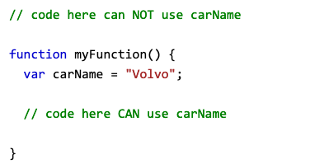
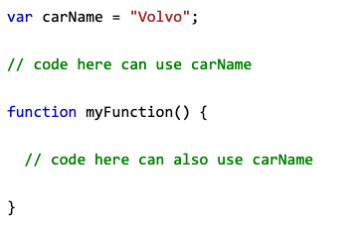
Terminology | Basic
Scope : Scope determines the accessibility (visibility) of variables and the portion of source code in which a binding of a name with an entity applies. (Local, Global)
Local variables have Function scope: They can only be accessed from within the function.
A variable declared outside a function, becomes GLOBAL and can be used by a function .
Example : https://www.w3schools.com/js/js_scope.asp

Slide 22
Terminology | Basic
Function : a block of reusable code that can be executed when called and that usually (but not always) returns a single value
Example :
var num = 0; function countUp(){
return num += 1;
} console.log( countUp() ); // displays 1
console.log( countUp() ); // displays 2
console.log( countUp() ); // displays 3
console.log( countUp() ); // displays 4

Slide 23
Terminology | Basic
Parameter : a variable containing data that is passed into a function.
Functions can accept no parameters, one parameter, or many. The number of parameters you need for your function is completely up to you and your current needs.
Example :
function addTwo( a, b ){ return a + b; } console.log( addTwo(2, 5) ); // displays 7 in the console.

Slide 24
Terminology | Basic
Argument : data that is passed into a function.
When you invoke a function, you can pass arguments to it.
Example :
function addTwo( a, b ){ return a + b; } console.log( addTwo(2, 5) ); // 2 and 5 are the arguments being passed to the function.

Slide 25
Terminology | Basic
Invoke / Call : is to trigger/execute/run a function.
Example :
function init(){ //do something } init(); // here is where the function "init" is invoked

Slide 26
Terminology | Basic
Concatenate: to link together in a chain or series.
JavaScript Syntax :
var userName = "Jermbo"; var msg = "Hello, " + userName; console.log(msg); // Hello, Jermbo
PHP Syntax :
$userName = "Jermbo"; $msg = "Hello, " . $userName; echo $msg; // Hello, Jermbo

Slide 27
Terminology | Basic
Instantiate : is to create an instance of a variable or object.
Example :
var color1; // this variable has only been declared var color2 = 'red'; // this variable has been instantiated

Slide 28
JavaScript Specific Terminology

Slide 29
Terminology | JavaScript
DOM : (Document Object Model ) - This is JavaScript API that gives you access to the structure of the HTML
https://youtu.be/l-0nPnSvbX8
https://youtu.be/b1ieJtIx1NY

Slide 30
Terminology | JavaScript
Browser / Client : This is the tool in which your users will view your program.

Slide 31
Terminology | JavaScript
Interpreter : Every browser has a built-in JavaScript interpreter.
The part of the browser that reads, understands, and runs the instructions in a JavaScript program is called the JavaScript "engine".
The JavaScript interpreter looks at each statement in the program and does what the statement says to do.
Your program runs as the JavaScript interpreter reads it.
When a browser reads and acts on a JavaScript program, it is called running or executing the program.

Slide 32
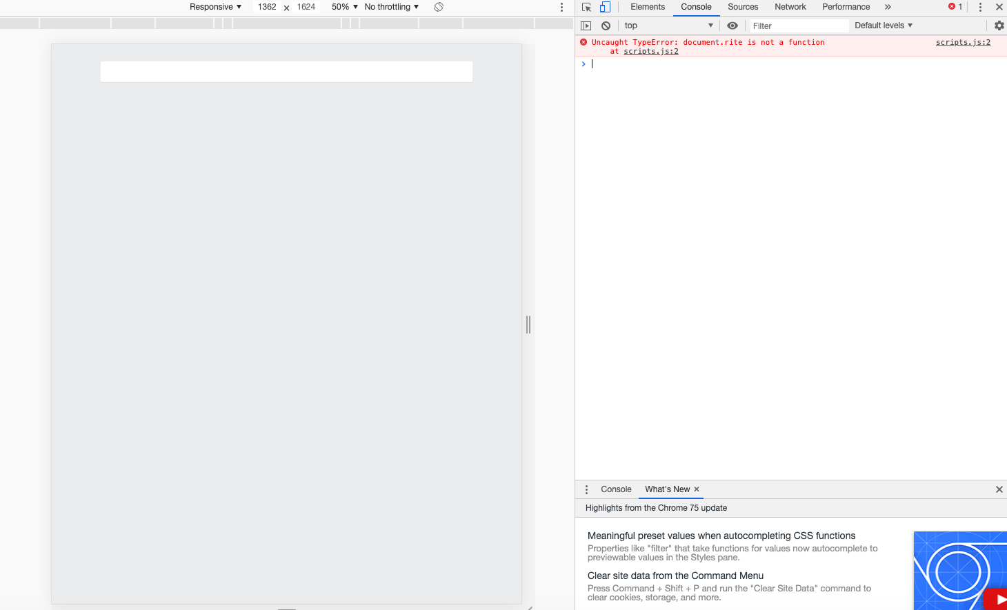
Terminology | JavaScript
Console : This is the tool used to inspect your code, allows you to set breakpoints, step through your code, log messages and more.

Slide 33
Terminology | JavaScript
Console Keyboard Shortcuts
Chrome Console Keyboard Shortcuts
Windows: Ctrl + Shift + J
Mac: Cmd + Option + J
Firefox Console Keyboard Shortcuts
Windows: Ctrl + Shift + K
Mac: Cmd + Option + K
Internet Explorer Console Keyboard Shortcuts
F12 key
Safari Console Keyboard Shortcuts
Cmd + Option + C

Slide 34
Terminology | JavaScript
How do you write Javascript into a page and where does it go?
Javascript can be directly written into the page using the <script></script> tags
Javascript can be placed in a separate sheet using the
<script src= “script.js”></script>
You cannot write it in between the script src tags only link to an external sheet
<script src= “script.js”></script>
If you place at the bottom of the page all the HTML will load first

Slide 35
Programming Logic
Javascript can display data in different ways
Writing into the HTML output using document.write()
Writing into an HTML element, using innerHTML
Writing a message into an alert box, using alert()
Writing into the browser console, using console.log()

Slide 36
Programming Logic
Writing into the HTML output using document.write()
<!DOCTYPE html>
<html>
<body>
<h1>Write the sum of 5 plus 6 </h1>
<script>
document.write(5 + 6);
</script>
</body>
</html>

Slide 37
Programming Logic
Writing into an HTML element, using innerHTML
<!DOCTYPE html>
<html>
<body>
<h1>Write the sum of 5 plus 6 into the empty paragraph</h1>
<p id=“demo”> </p>
<script>
document.getElementById(“demo”)inner.HTML = 5 + 6;
</script>
</body>
</html>

Slide 38
Programming Logic
Writing into an alert box, using alert()
<!DOCTYPE html>
<html>
<body>
<h1>Write the sum of 5 plus 6 into an alert box</h1>
<script>
alert(5 + 6);
</script>
</body>
</html>

Slide 39
Programming Logic
Writing into the browser console, using console.log()
<!DOCTYPE html>
<html>
<body>
<h1>Open the "Console" in the debugger menu to view the result</h1>
<script>
console.log(5 + 6);
</script>
</body>
</html>

Slide 40
Programming Logic
2
How does the program make decisions?

Slide 41
Programming Logic
Computers do exactly what you tell them to do. They need instructions on how to make a decision, how many times to run an operation, or what happens when the program ends.
You have a few decision-making tools at your disposal.
If Statement
If / Else Statement
If / Else If / Else Statement
Switch Statement
For Loop
While Loop
http://www.tutorialspoint.com/computer_programming/computer_programming_decisions.htm

Slide 42
Programming Logic
If Statement : There are two major parts to an If Statement: the conditional statement and the code to be executed.is a conditional statement that evaluates a parenthetical expression. If the expression is true, the program runs the block of code inside braces. If the expression isn't true, the program continues after the braces.
Example :
var x = 7;
if ( x < 5 ) {
console.log("This runs only if x is less than 5. It's", x);
}
if ( x > 5 ) {
console.log("This runs only if x is more than 5. It's", x);
}
console.log("This runs regardless of the value of x.");

Slide 43
Programming Logic
If / Else Statement : much like the if statement, but if the condition is found to be false, the program will run the code associated with the else statement.
Example :
var x = 10; if( x < 5 ){ console.log( 'x is less than 5' ); }else{ console.log( 'x is greater than 5'); }

Slide 44
Programming Logic
If / Else If / Else Statement : an if statement can be followed by optional else if … else statements which make it useful to test multiple conditions.
Example :
var x = 10; if( x < 5 ){ console.log( 'x is less than 5' ); }else if( x == 10){ console.log( 'x is equal to 10'); }else{ console.log( 'x is greater than 5 and not equal to 10' ); }

Slide 45
Programming Logic
Switch Statement : an alternative to if statements, switch statements allows a variable to be tested for equality against a list of values. Uses case for the values compared, break for breaking out of switch block and default the code to run if no case match.
Example :
var x = 10; switch ( x ){ case 5: console.log(' x is equal to 5' ); break; case 10: console.log( 'x is equal to 10'); break; default: console.log(' x is neither 5 nor 10'); }

Slide 46
Programming Logic
For Loop : a programming control statement for specifying iteration, which allows code to be executed repeatedly.
Example :
for( var i = 0; i < 100; i++ ){ console.log( 'i is = ' + i ); // logs out "i is = 1… 100" }
For loops have three parts. Initiator, condition, incrementor.
First you declare a variable to be counted. Then you check to see if condition is true or false, if true : run the block of code and add to the incrementor, if false : exit loop.

Slide 47
Programming Logic
While Loop : a control flow statement that allows code to be executed repeatedly based on a given boolean condition.
Example :
var isCompleted = false; var i = 0; while( !isCompleted ){ i++; if( i >= 10 ){ isCompleted = true; } }
Beware of the Infinite Loop. In both loops, you need a way to stop the code from executing, you need something that will eventually equate to false and stop the process.

Slide 48
In Class Exercises
3

Slide 49
Terminology | Basic
Create the following web page in public_html/class-samples and save it as javascript1.html and view it in your browser: Create an Alert window
<!doctype html> <html> <body> <p>This is my web page</p> </body> </html>
Notes:
Discuss what these evaluate to

Slide 50
Terminology | Basic
Move the Javascript to an external file
Create a js folder in public_html/class-samples/
Cut and Paste the Javascript code from the previous exercise into a new external.js file and save it in public_html/class-samples/js
Modify the <script> tag in your HTML file (see below), save the file as javascript2.html in public_html/class-samples/and view it in your web browser.
<!doctype html> <html> <body> <p>This is my web page</p> <script src="js/external.js"></script> </body> </html>
Notes:
Discuss what these evaluate to

Slide 51
Terminology | Basic
Working With the Console
Add the following to your external.js file
Write something into the page using JS
Print a message into the console at the start and end of your program
Open the console
Notes:
Discuss what these evaluate to

Slide 52
Terminology | Basic
Working With the Console
Save the javascriptexercise.html file sent to you into public_html/class-samples/ folder
Copy and paste text into a new script.js file and save in class-samples/js folder
Save the script.js file sent to you into public_html/class-samples/js folder
Open the javascriptexercise.html file sent to you, in the Chrome web browser
Debug the issue(s) using the console
Correct the mistakes in Brackets and re-save the file
Notes:
Discuss what these evaluate to

Slide 53
Terminology | Basic
Store Something In a Variable
Create a new file called variables.html file and save it to the public_html/class-samples/ folder
Create a new script file called variables.js and save it to the public_html/class-samples/js
Call the external script file in the variables.html page
Open the variables.js file and create a variable named message and assign the value Hello!
Make the variable content appear in an alert window when you launch the variables.html page.
Notes:
Discuss what these evaluate to

Slide 54
Terminology | Basic
Change the variables content
Save new file variables.html as variables2.html to the public_html/class-samples/ folder
Save the new script file variables.js as variables2.js and save it to the public_html/class-samples/js
Change the content of the message variable to Welcome to PBCS!
Open another alert window
Notes:
Discuss what these evaluate to

Slide 55
Terminology | Basic
Simple Function
Create new file function.html in the public_html/class-samples/ folder
Save a new script file function.js as variables2.js and save it to the public_html/class-samples/js
Define and then call a function which performs an addition calculation, and returns the result in the console.
Notes:
Discuss what these evaluate to

Slide 56

Homework (Prep for Javascript 102)
Complete Treehouse Javascript Basics lesson: https://teamtreehouse.com/library/javascript-basics [381 min]
Introduction to JavaScript
Storing and Tracking Information with Variables
Creating Reusable Code with Functions

